Slide 1
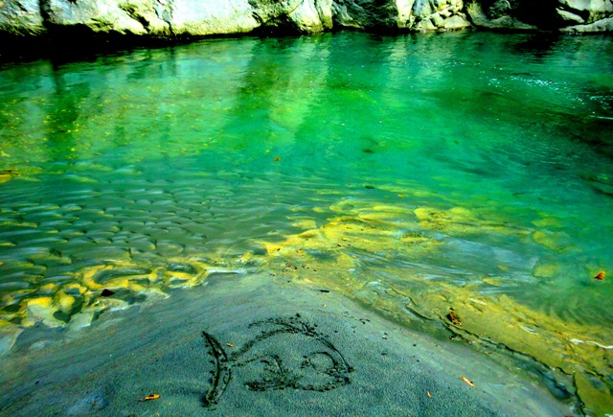
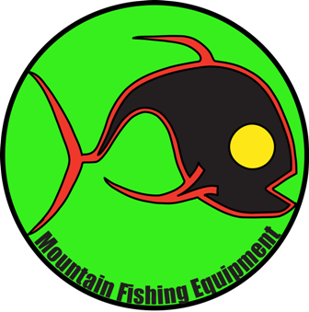
Mountain Fishing Equipment
2012
Fishing rods - Accessories - Gear for fun time

Slide 2
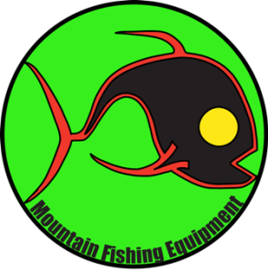
Introduction to our Company
We are designers of sport fishing equipment, and we are fishermen. Thanks to our extensive background in the sport fishing industry, our products are designed to be the best in terms of efficiency.
Every fisherman knows that expensive and fancy material can't change the fact that you are good at using it. Our fishing rods are made only with solid materials: high resistance carbon, stainless steel and aluminum.
We offer a 360 degrees help on any side of the production of sport fishing equipment, and produce a high quality range of products.
Mountain Fishing Equipment Limited is a design company for sport fishing equipment, and we personally test every of our product before putting it on the market. During this phase we know that we have a big responsibility on the customer, so we pay particular attention to all the smallest details of our items.
Looking forward to enlarge our products portfolio soon, by now we are very satisfied of the results that we have achieved. With our current products we cover most of the fun that a fisherman can get, and we are willing to continue improving the fisherman's life.
Consulting You can tell us how to make your own fishing rods, we will follow the process for you and deliver you the final product. This service is for shops, fishing clubs or anyone who wants to produce some fishing rods
Mission increase the level of enjoyability of sport fishing by adding value to it through our products.
Vision become a recognized and renowned quality brand for sport fishing equipment.
People Design and business development: Fabrizio Rustichelli (Italy)
Testing and marketing: Simon Abernathe (Australia)
Sales executive: Vanilla Lai (Hong Kong)
Our Motto: "Horas non numero, nisi serenas“ (“I don’t account for any hour, except the happy ones”)
Intellectual property, trade marks and copyright rights:
Mountain Fishing Equipment ltd and logo, is a registered trademark. Is illegal every unauthorized reproduction, copy or use of the content of this catalog Mountain Fishing Equipment ltd reserves the right to prosecute every unauthorized use and user of the contents of this catalog.

Slide 3
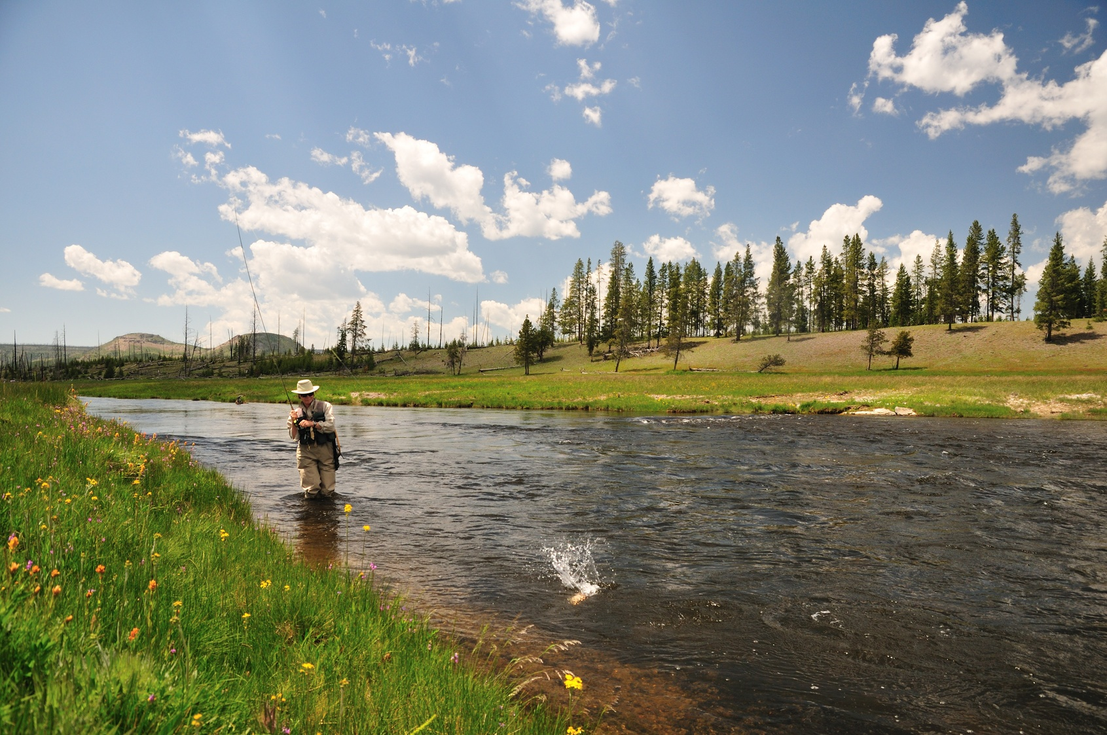
Index
Spinning pag 1/2
Fly pag 3/4
Carp pag 5
Touch pag 6
Bottom / Sea pag 7
Trolley pag 8
Sunglasses pag 9
Raincoat pag 10
Video camera pag 11
Consulting pag 12
"Horas non numero, nisi serenas“

Slide 4
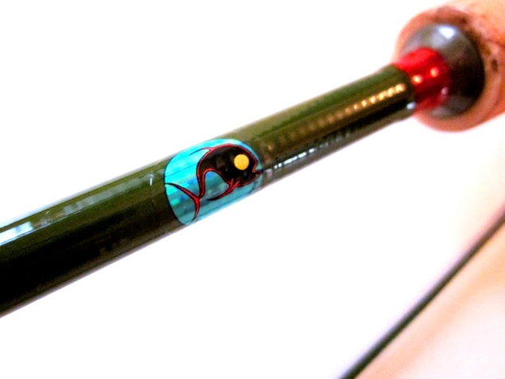
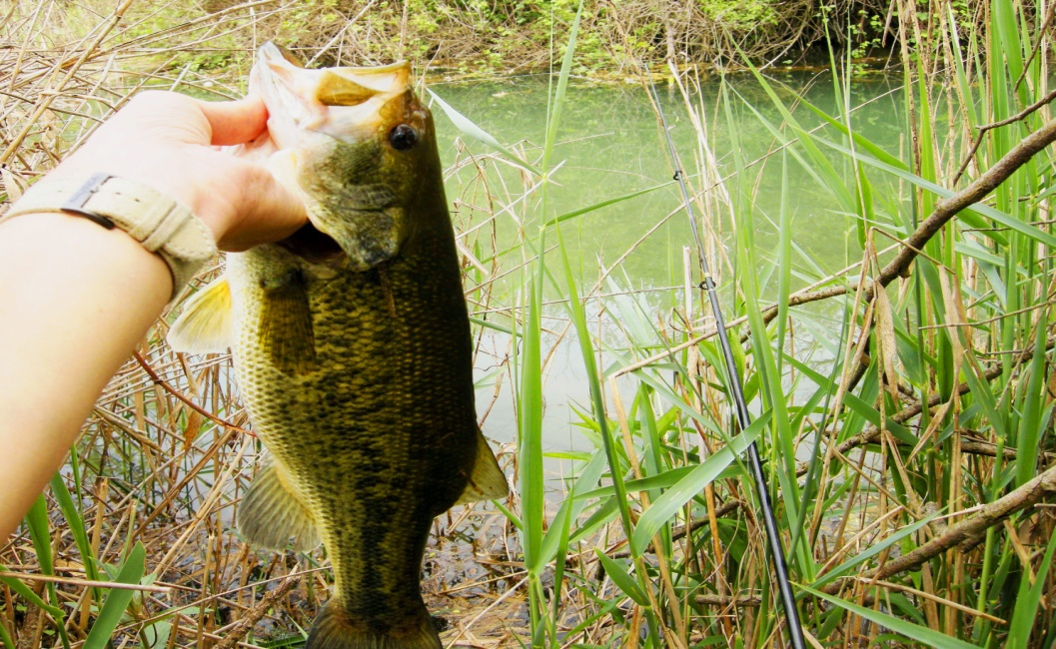
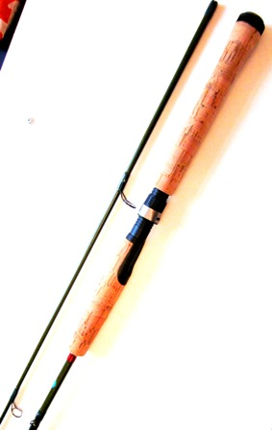
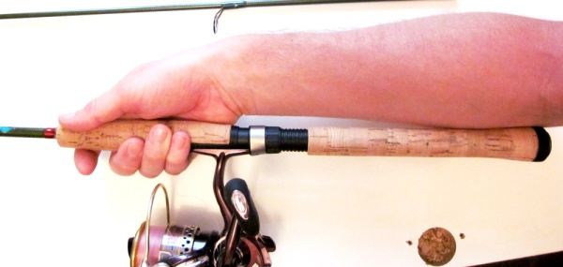
Spinning
Bass and Trout
Adrenaline 2.1 mt 7ft 5-15 gr.
The Mountain Fishing Equipment 2,10 mt. / 7 foot , 5 to 20 gr."Adrenaline" spinning rod.
Very light, strong, balanced, on the handle, progressive top action. ideal for soft bait and light bait casting. With the fast reaction handle design you won't miss a strike. Guides completely in super thin stainless steel and super smoothed stainless steel.
1

Slide 5
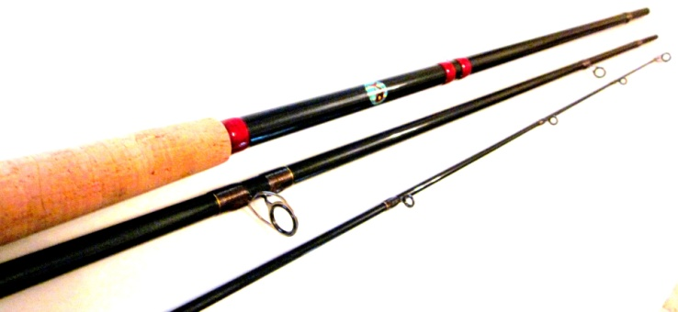
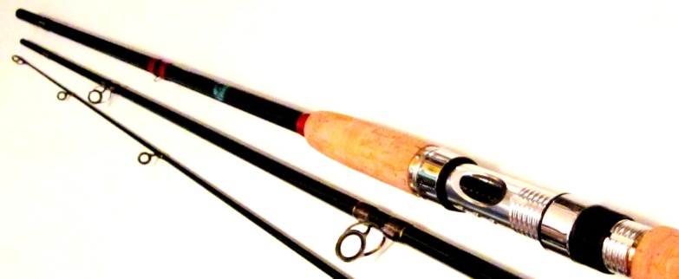
Spinning
Salmon - Pike
Best Pal 3,40 mt / 11 foot , 3 sections, 15 to 30 gr. spinning rod. Progressive top action, fast strike-response handle in A grade cork, high grade carbon with SIC stone guides and stainless steel frame structure.
A real jewel, tailor designed, easy to manage and reliable, allows you to have the best fishing action and helps you during the retrieve of big fish.
Bonzer Top 3,10 mt, 10 foot, 3 sections, 15 to 30 gr. spinning rod. Marked top action, strong and versatile, can be used both in salt and freshwater, nice reel seat in aluminum and guides in SIC stone and stainless steel. Very reliable tool for pike and other big pray fish.
2

Slide 6
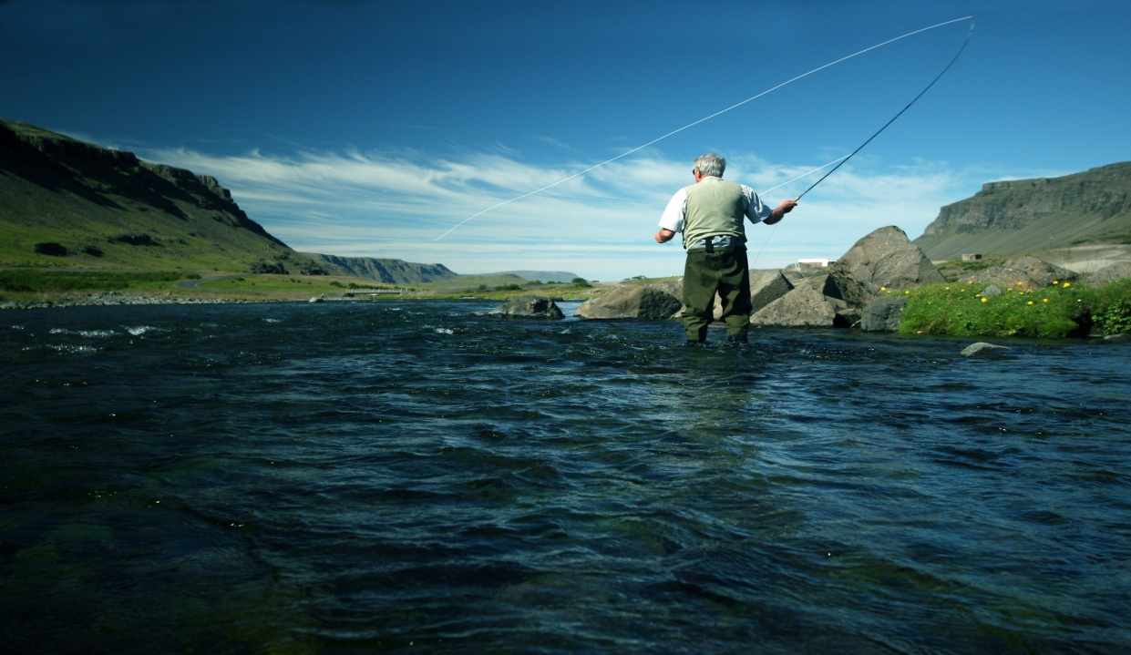
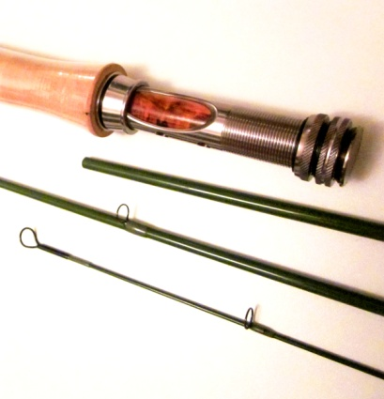
Fly
ALPHA series
.
ALPHA Fly rods 2,70 mt. 9 foot, 4 sections, for easy transport. Completley made with T46 High Carbon. The best rods material on the market.
Exceptional strenght, lightness and precision of casting. Grade A cork handle, anodized alloe reel seat, guides in anodized tiatnium.
If you want something to exceed your expectations.
Get used to the best.
Available in:
2,70 mt – 7 foot ALPHA # 3-4
2,70 mt – 7 foot ALPHA # 5
2,70 mt – 7 foot ALPHA # 6
2,70 mt – 7 foot ALPHA # 8
3

Slide 7
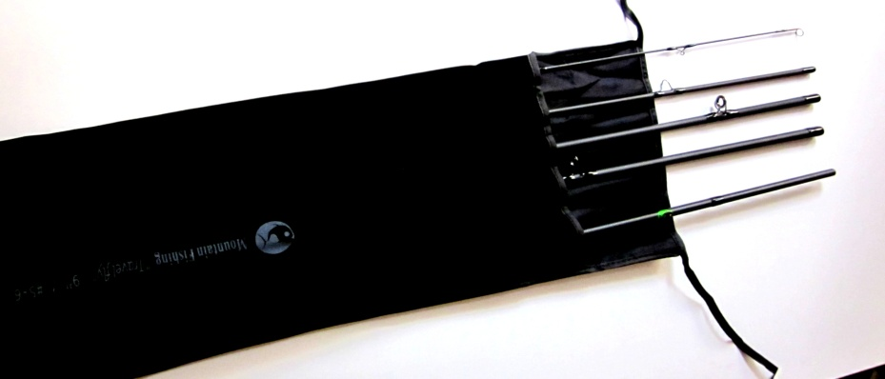
Fly
ORCHESTRA series and TRAVEL
ORCHESTRA Fly rod 2,7 mt - 9ft, 4 sections for easy transport. Materials: rod- Carbon T36, guides- anodized titanium, reel seat- super light aluminum, handle- grade A cork, "Orchestra" series.
Available in:
2,7 mt - 9ft Orchestra #3-4 2,7 mt - 9ft Orchestra # 5
2,7 mt - 9ft Orchestra # 6 /7 2,7 mt - 9ft Orchestra # 8/9
Travel Fly: 2,7 mt - 9 ft, 5 sections, #5/6 calibrated, light and extraordinary. This rod is the result of years of study and sampling of Mountain Fishing Equipment technicians and fishermen.
It will help you to make a perfect roll cast in difficult environments, to control a big fish or to aim at the exact spot where to place your fly. Amazing good in windy and difficult environments, is a jewel made of high carbon with the first 2 sections reinforced with the special "K" cloth which gives to the rod an amazing balance of strength and smoothness. In addition the reduced length when closed (only 62 cm/24,5 inch) make it very handy for transportation or storage in narrow environments like cars and closets. You can place it in your normal travel bag instead of going around in the airport with your expensive fishing rod tube, decreasing the risk of losing it or braking it.
4

Slide 8
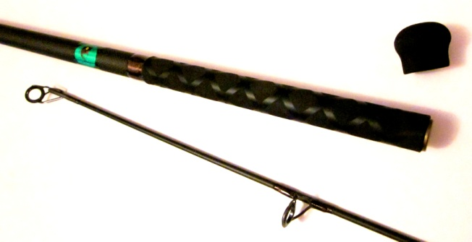
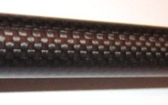
Carp
XXX series
XXX 3,90 mt. 14 foot 3lbs action series XXX. Materials: high carbon reinforced with super high resistance carbon cloth, guides frame in gun smoke titanium and stone zirconium oxide (SIC), reel seat-alluminium and carbon fiber plate. EVA hand grip and fight cap on the bottom of the rod. You just have to hold this rod in your hands to feel all its power, compressed in a super-thin body, just 1,75 at the base, and 1,5 cm near the reelseat. Increase your casting range and manage easilly big fish.
Really a step forward from an average carp fishing rod.
XXX 3,60 mt. 3lbs action series XXX. Materials: high carbon reinforced with super high resistance carbon cloth, guides frame in gun smoke titanium and stone zirconium oxide (SIC), aluminum and carbon fiber plate. EVA hand grip and fight cap on the bottom of the rod. You just have to hold this rod in your hands to feel all its power, compressed in a super-thin body, just 1,75 at the base, and 1,5 cm near the reel seat. Increase your casting range and manage easilly big fish.
Really a step forward from an average carp fishing rod.
5

Slide 9
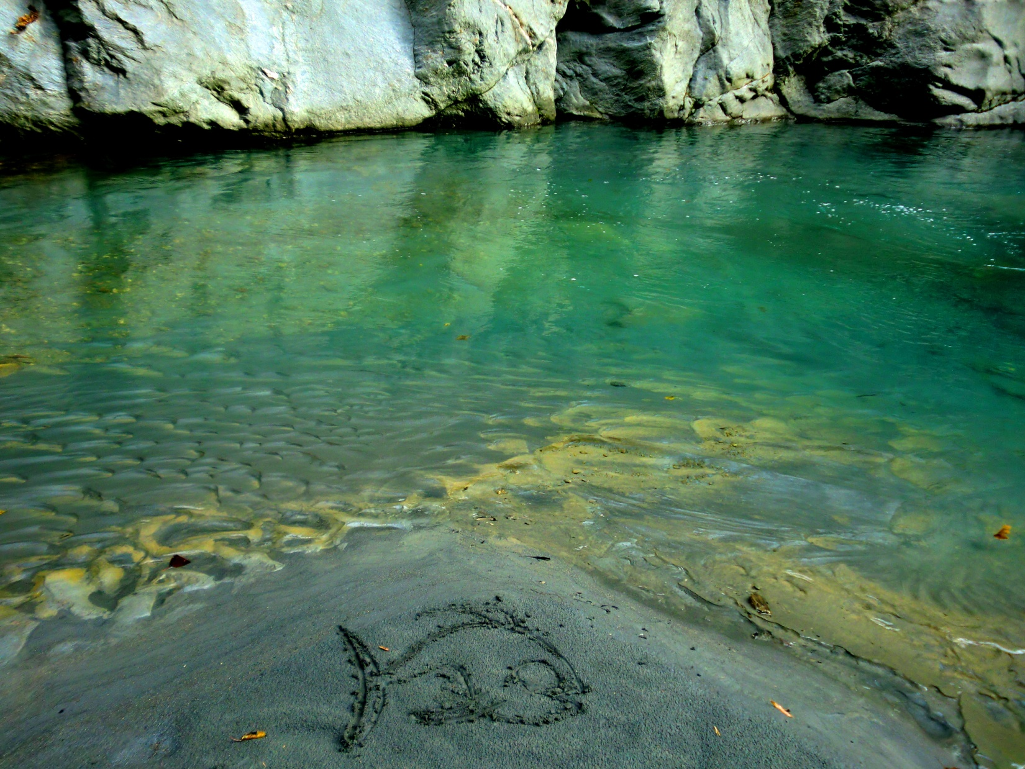
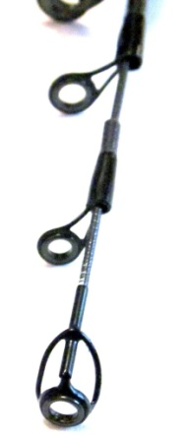
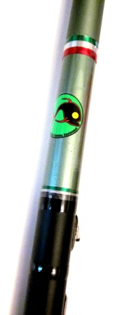
Touch
Creek Master touch fishing rod top action, 5,5mt, 3-15 gr. Materials:rod-60%high carbon and 40% carbon T-40, guides- stainless steel and zirconium oxide.
Light and tough, extremely balanced, will help you to control the bait in any position. "Creek Master" series.
Available in :
4,75 mt 15,8 foot Creek Master
5,75 mt 18,86 foot Creek Master
6,75 mt 21,5 foot Creek Master
6

Slide 10
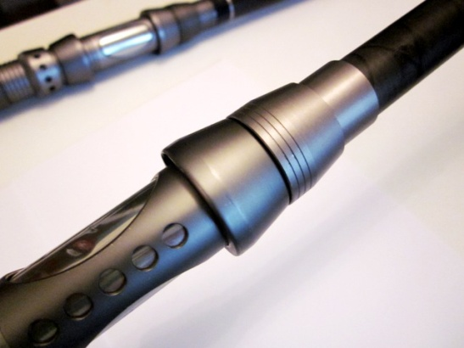
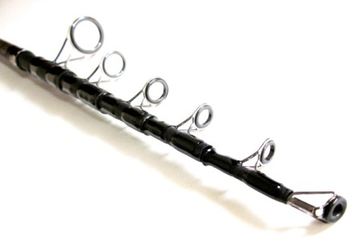
Rock / Sea
Sea Power 3,6 mt 13 feet
Sea Power telescopic 3,60 13 feet rock / bottom fishing rod, 30 to 60 gr action. Materials: reel seat in aluminum and plate in stainless steel, rod-high carbon, handle with anti static EVA grip, guides in stainless steel and zirconium oxide. Can manage any situation of fishing included live bait drifting. very tough fishing rod, is ideal for carps or sea fishing.
Available in :
3,6 mt 13 feet Sea Ruler
4,2 mt 15 feet Sea Ruler
7

Slide 11
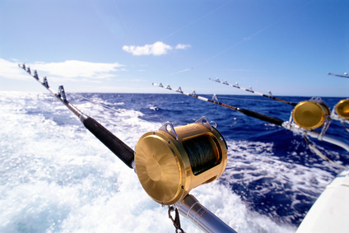
Trolley / Bottom
Paloma series
Paloma 1,6 mt 4,8 feet 20 to 40 to 80 lbs
Body in mix carbon and fiber glass, top guide in aircraft alluminum anti stain
Available in:
1,6 mt 4’8” feet Paloma trolley 20 to 40 lbs
1,65 mt 4’82” feet Paloma trolley 40 to 80 lbs
Paloma multicool
Paloma Multicool 1,8 mt 6 feet -20 to 50 grams. Top action, made in high carbon fiber with pvc anti static grip handle. SIC guide stone, stainlass steel guides frame.
If you are on a boat, this marvellous rod is the ace in your sleeve.
On a boat, this rod can do everything: trolley, bottom fishing, jigging, spinning and casting. In 2 sections for reduced storage space (95 cm closed)
Available in :
1,8 mt 6 feet 20/50 gr top action Paloma Multicool
8

Slide 12
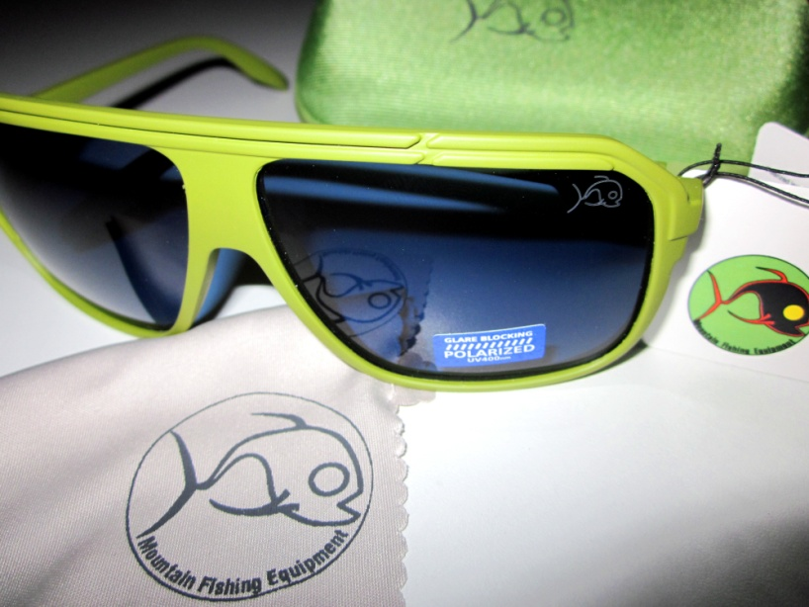
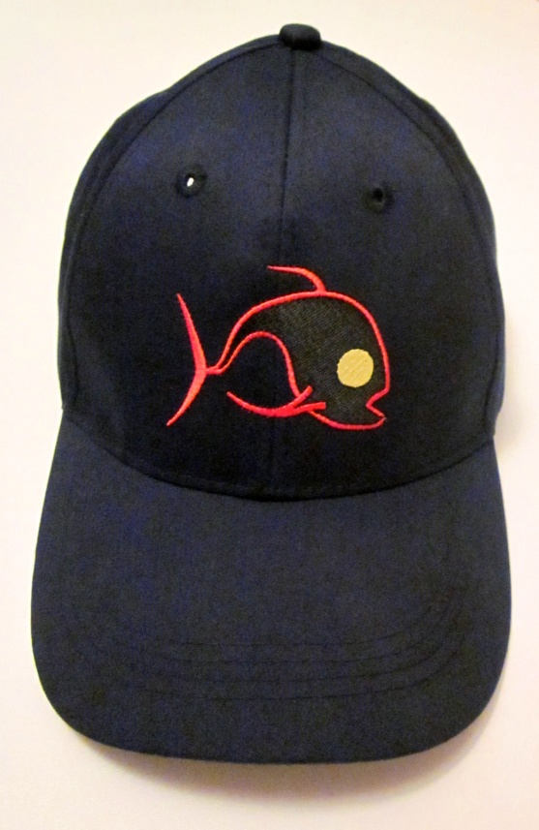
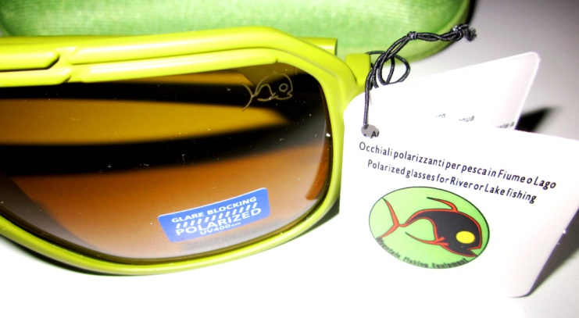
Sunglasses
Hat
Super polarized Sunglasses Protection Level 1-2-3
Super Polarized: Erase the glare from the water surface, designed and tested for fishing and outdoor activities.
These sunglasses with blue polarized lenses, are ideal for SEA or Boat fishing, or activities with open spaces and high UV glare. Protection level 3
The Mountain Fishing Research team developed these sunglasses with high quality polarized lenses and in olive matt color, with RETRO STYLE design.
We developed new lenses with HIGHER GLARE-ERASING POWER, and processed them with a NEW ANTI-SCRATCH TREATMENT.
TAKE A STEP FORWARD IN UNDERWATER VISION WITH THE GLARE ERASING POWER OF THESE NEW GLASSES.
Available in:
Super polarized Blue protection 3
Super polarized Orange protection 1/2
100% cotton 200 grains, super cap with inside sweat band, velcro strap to close on the back, Mountain Fishing Equipment logo on the front.
Not only for fishermen, if you want to be cool, take the shortcut with this cap.
Available in: Navy blue
9

Slide 13
Raincoat
Foldable raincoat : our research and testing team has created for you a multi-purpose raincoat that will help you to go through tough weather and bushy environments. PVC coated cotton, 100% waterproof, windproof and scratchproof, will lead you through the toughest weather conditions allowing you to concentrate on your recreational activity at your best. If you don't need the full length of the raincoat you can fold it inside and block it with some hooks. It will become a normal size jacket.
Available in:
Foldable raincoat - unisize Blue
Foldable raincoat - unisize Olive
10

Slide 14
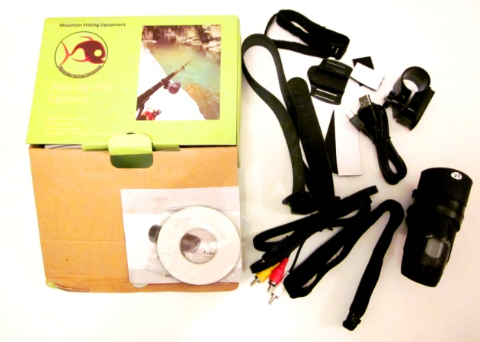
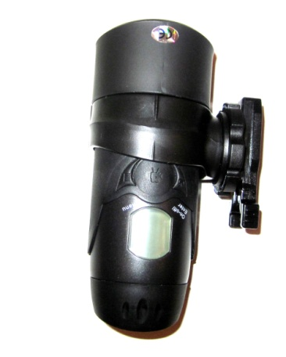
Videocamera
Fishing Camera Mountain Fishing Equipment assembled for you this complete kit with the right tools to adapt the camera to any kind of recording placement.
Ideal for Spearguns, Guns,Fishing rods, Bikes, Helmets, and whatever you can fix it on.
360 degrees vertical and horizontal freedom of movement. It can be pointed it in any direction from its attachement point (from up to down, and from side up to side down) and will hold the position you gave it.
Inside the box:
- plastic ring that allows to hold it round surfaces (rods, bike handle, rifles, spearguns, whatever round pipe...)
- rubber band for helmet-cam
- magnetic sticker to fix the camera on smooth metal surfaces
- fabric grip to sew on the jacket for the shoulder camera positioning.
- multi-exchangable plug for the camera on different surfaces.
- Cables: USB - TV
3 mt waterproof
Available in:
Fishing rod Camera
11

Slide 15
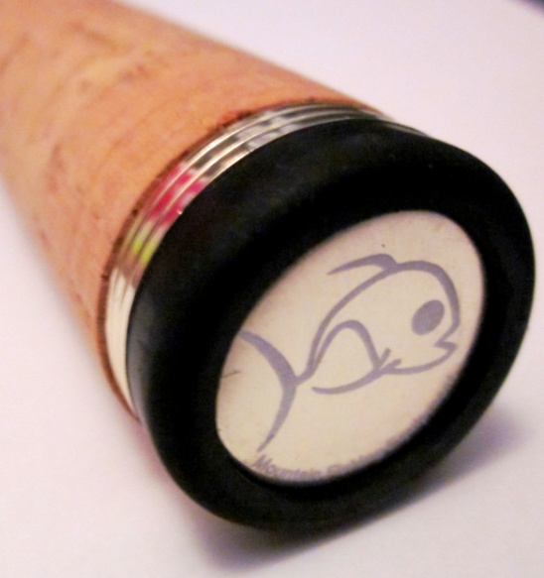
Consulting
You want to
make a small production of customized fishing rods
produce some fishing rods
or
you are already producing fishing rods
we will develop the project for you
Idea for fishing clubs and shops
You can use our extensive network and expertise to build your fishing rod exactley as you want it, even a personalized limited edition, saving time money and avoiding scams. Make a tailored production for your shop or Club.
We are professional in this industry for many years and our team’s resources are outstanding.
Save precious time, money and boost your business with our help!
Contact us by phone or email:
Head office: 00852 2869 6114
Consulting email: fab@mofeq.com
12

Slide 16
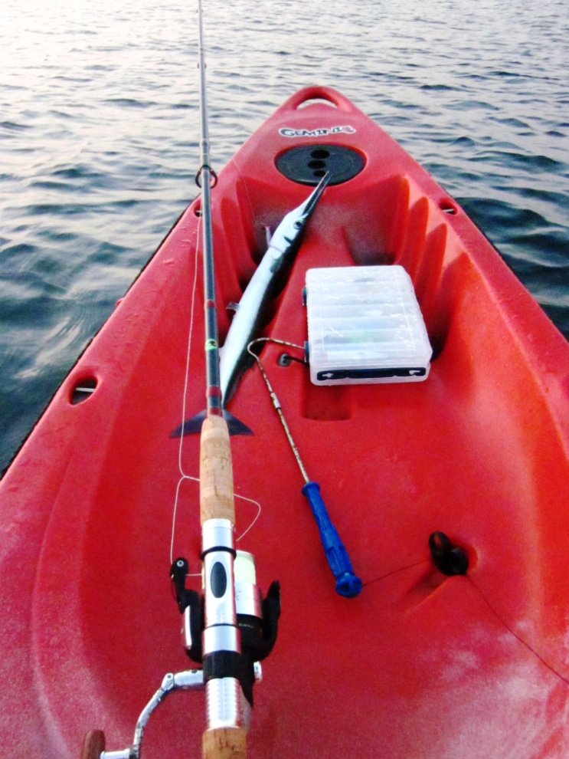
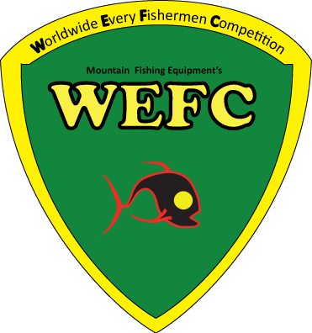
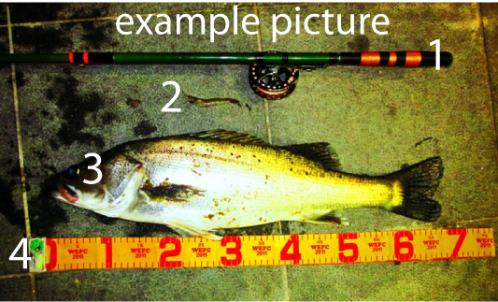
Mountain Fishing Equipment
the
Official Sponsor of
WEFC fishing competition
WEFC is a Worldwide online fishing competition. The competitors can participate from any part of the World by sending a picture, and can win the Mountain Fishing Equipment products.
Contacts us
Sales office: quotations/orders/info
Hong Kong direct import line
Email sales@mofeq.com
Fax 00852 2869 6114
Mountain Fishing Equipment Ltd.
Head office address:
3F/N.2
Lan Kwai Fong n.3
Central
Hong Kong
Tel/Fax: 00852 2869 6114
Visit the website for more
www.mofeq.com
Free subscription at
www.wefc.it
"Horas non numero, nisi serenas“

